Slide 1
What is API and API Testing

Slide 2
Learning Objectives
What is API
What is API Testing
API Testing Types
Common tests on APIs
Advantages of API Testing
What exactly needs to be verified in API Testing
Tools used for API Testing
Difference between API testing and Unit Testing
Challenges in API testing
API Testing Best Practices

Slide 3
What is API
What is an API?
API is an acronym and it stands for Application Programming Interface. API is a set of routines, protocols, and tools for building Software Applications. APIs specify how one software program should interact with other software programs.
Routine: a program that performs a particular task. Routine is also known as procedure, function or subroutine.
Protocols: A format for transmitting data between two systems.

Slide 4
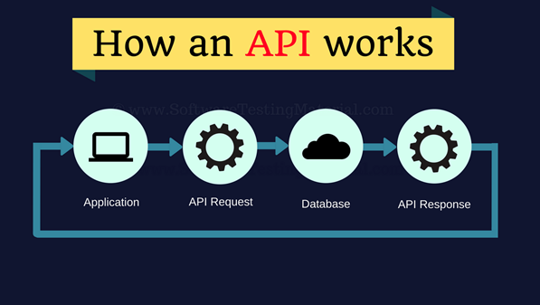
What is API
In simple words, API stands for Application Programming Interface. API acts as an interface between two software applications and allows the two software applications to communicate with each other. API is a collection of software functions which can be executed by another software program.

Slide 5
What is API
Let’s see some examples of an API in a more approachable way.
Assume an API as a Waiter at a Restaurant.
At a restaurant, you give an order based on the items available on the menu. A waiter in the restaurant writes down your order and delivers it to the kitchen who prepares your meal. Once the meal is ready, the waiter picks up your food from the kitchen and serves it to you at your table.
In this scenario, the waiter’s role is similar to an API. As a waiter, the API takes a request from a source, takes that request to the database, fetches the requested data from the database and returns a response to the source.

Slide 6
What is API
If you are using a flight service engine say Expedia, where you search for flights on a specific date. Once you pass the data such as Source, Destination, Onward Date and Return Date and click on search. Expedia sends a request to airlines through an API as per your search details. The API then takes the airline’s response to your request and delivers it right back to the Expedia.
API gets the request from the user and gives the response without exposing internal logic. API acts like an Abstraction in OOPs concept.

Slide 7
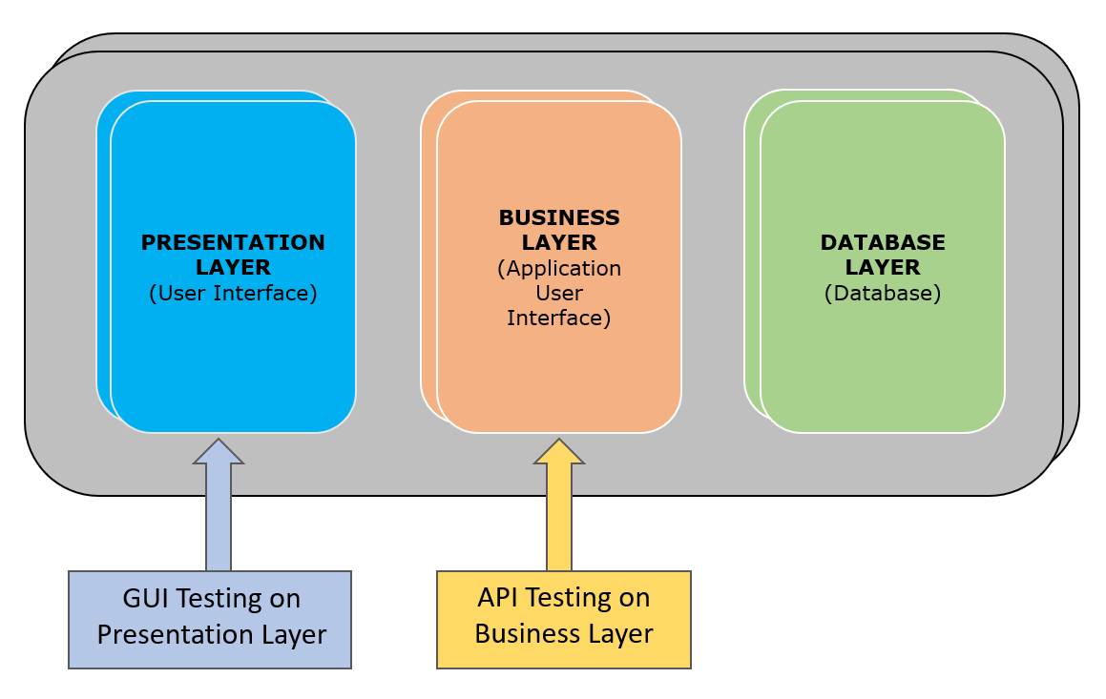
What is API
API testing is a type of software testing that involves testing APIs directly and also as a part of integration testing to check whether the API meets expectations in terms of functionality, reliability, performance, and security of an application.

Slide 8
What is API
In API Testing our main focus will be on a Business logic layer of the software architecture. API testing can be performed on any software system which contains multiple APIs. API testing won’t concentrate on look and feel of the application. API testing is entirely different from GUI Testing.

Slide 9
What is API
Let’s see how is UI testing is not similar to API testing?
UI (User Interface) testing is to test the graphical interface part of the application. Its main focus is to test the look and feel of an application. On the other hand, API testing enables communication between two different software systems. Its main focus is in the business layer of the application.
API TESTING:
API testing is conducted by QA Team
API testing is a form of Black box testing
API testing is conducted after the build is ready for testing
Source code is not involved in API testing
In API testing, the scope of testing is wide, so all the issues that are functional are considered for testing

Slide 10
API Testing Types
API testing typically involves the following practices:
Unit testing: To test the functionality of individual operation
Functional testing: To test the functionality of broader scenarios by using block of unit test results tested together
Load testing: To test the functionality and performance under load
Runtime/Error Detection: To monitor an application to identify problems such as exceptions and resource leaks
Security testing: To ensure that the implementation of the API is secure from external threats
UI testing: It is performed as part of end-to-end integration tests to make sure every aspect of the user interface functions as expected

Slide 11
API Testing Types
Interoperability and WS Compliance testing: Interoperability and WS Compliance Testing is a type of testing that applies to SOAP APIs. Interoperability between SOAP APIs is checked by ensuring conformance to the Web Services Interoperability profiles. WS-* compliance is tested to ensure standards such as WS-Addressing, WS-Discovery, WS-Federation, WS-Policy, WS-Security, and WS-Trust are properly implemented and utilized
Penetration testing: To find vulnerabilities of an application from attackers
Fuzz testing: To test the API by forcibly input into the system in order to attempt a forced crash

Slide 12
API Testing Types
Common tests on APIs:
Some of the common tests we perform on APIs are as follows.
To verify whether the return value is based on input condition. Response of the APIs should be verified based on the request.
To verify whether the system is authenticating the outcome when the API is updating any data structure
To verify whether the API triggers some other event or request another API
To verify the behavior of the API when there is no return value

Slide 13
Advantages of API Testing:
API Testing is time effective when compared to GUI Testing. API test automation requires less code so it can provide faster and better test coverage.
API Testing helps us to reduce the testing cost. With API Testing we can find minor bugs before the GUI Testing. These minor bugs will become bigger during the GUI Testing. So finding those bugs in the API Testing will be cost effective to the Company.
API Testing is language independent.
API Testing is quite helpful in testing Core Functionality. We can test the APIs without a user interface. In GUI Testing, we need to wait until the application is available to test the core functionalities.
API Testing helps us to reduce the risks.

Slide 14
What exactly needs to be verified in API Testing
Basically, on API Testing, we send a request to the API with the known data and we analyse the response.
Data accuracy
HTTP status codes
Response time
Error codes in case API returns any errors
Authorization checks
Non functional testing such as performance testing, security testing

Slide 15
Tools used for API Testing:
Some of the tools used for API Testing are as follows:
Postman
Katalon Studio
SoapUI
Assertible
Tricentis Tosca
vREST
JMeter
Rest-Assured
Karate DSL
SOAP Sonar

Slide 16
Challenges in API testing:
Some of the challenges we face while doing API testing are as follows
Selecting proper parameters and its combinations
Categorizing the parameters properly
Proper call sequencing is required as this may lead to inadequate coverage in testing
Verifying and validating the output
Due to absence of GUI it is quite difficult to provide input values

Slide 17
Types of bugs we face when performing API testing:
Issues observed when performing API testing are
Stress, performance, and security issues
Duplicate or missing functionality
Reliability issues
Improper messaging
Incompatible error handling mechanism
Multi-threaded issues
Improper errors

Slide 18
Summary
What is an API
What is API Testing
API Testing Types
Common tests on APIs
Advantages of API Testing
What exactly needs to be verified in API Testing
Tools used for API Testing
Difference between API testing and Unit Testing
Challenges in API testing
API Testing Best Practices

Slide 19
Questions

